Slide 1

Gastrointestinal Polyp Classification and Segmentation
COVER SLIDE
GROUP 7
SAMAY KALPESH PATEL
PRIYAM THAKKAR
ISHIKA THAKUR
SREEYA SOMAL
MANMITA
ADITYA RANGNATHAN

Slide 2
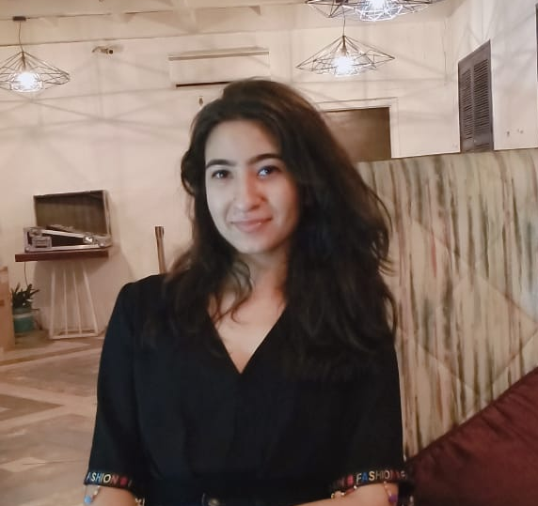
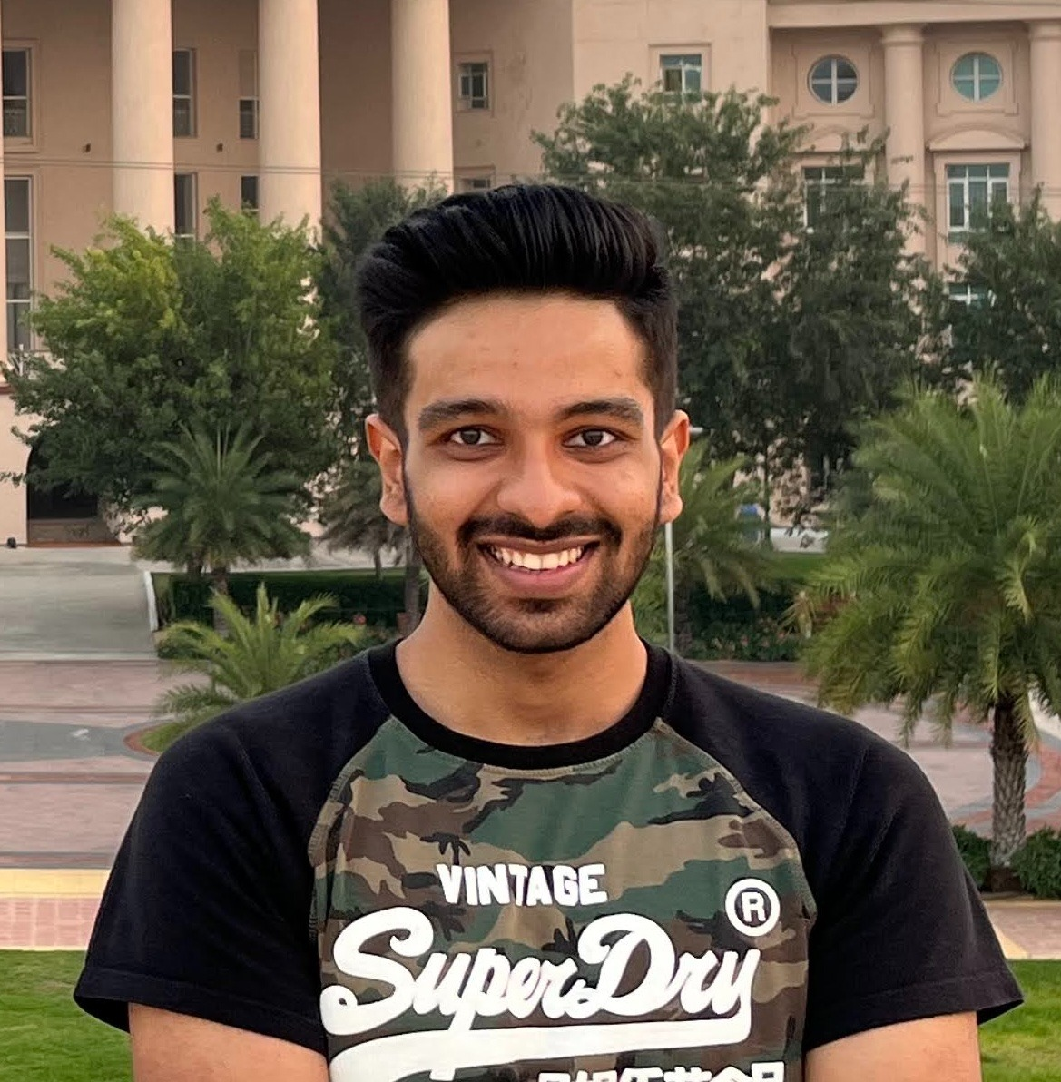
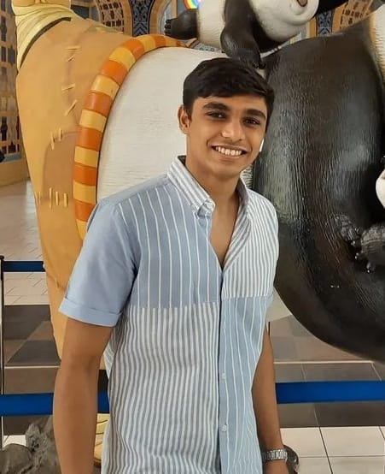
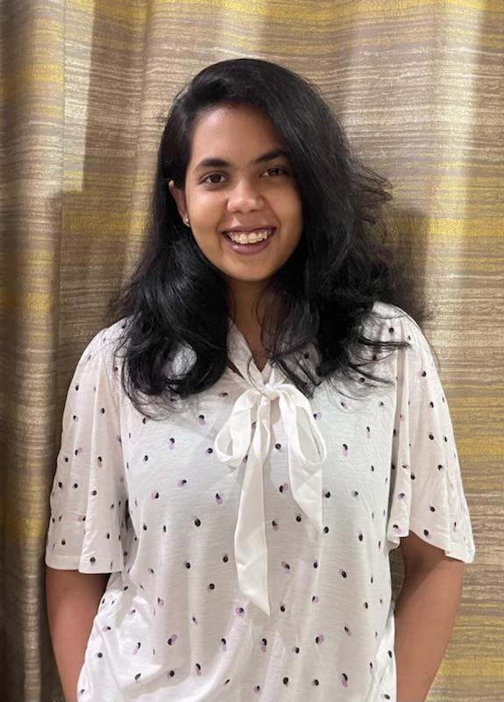
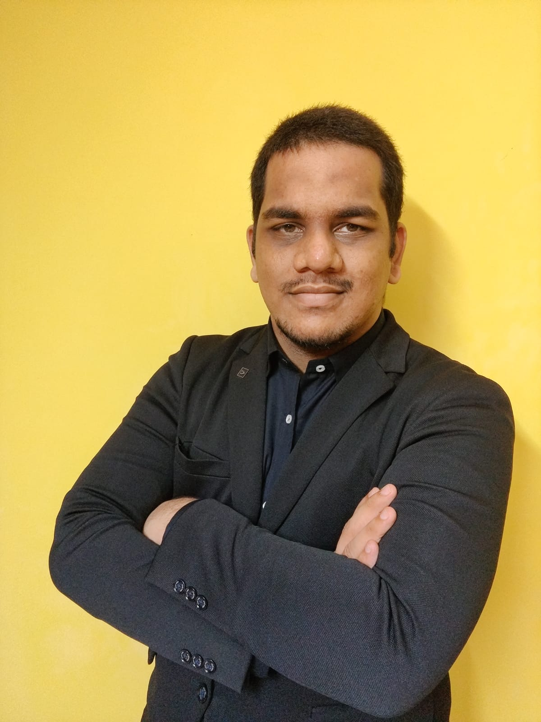
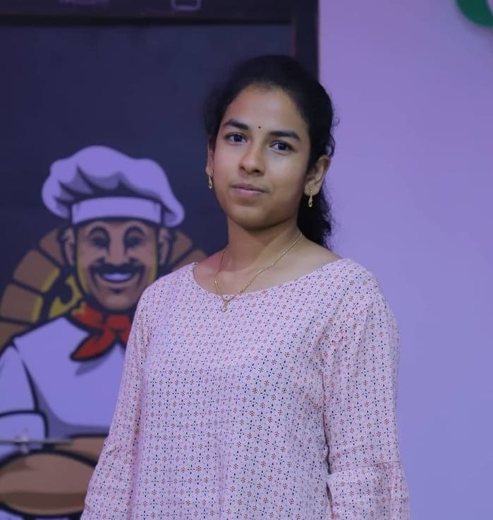
Ishika Thakur
Model and Security
Priyam Thakkar
Model,Data Pre-processing
Samay Patel
Model and Data
Manmitha Polsani
Frone-end and Deployment
Sreeya Somal
Deployment and Security
Aditya Ranganathan
Business model

Slide 3
Problem Statement
To Classify and Further Segment Polyp Image
To aid Doctors in Decisions Regarding
Treatment
Help in Robot Surgeries
Help To get a better Analysis of Polyp
Automatic detection of more polyps at an early
stage can play a vital role in improving both
prevention of and survival from colorectal cancer

Slide 4
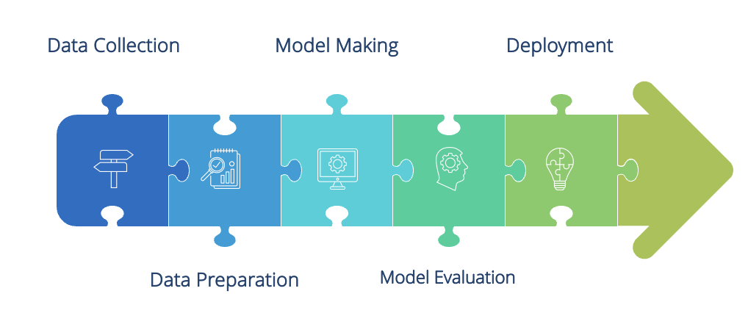
Model Pipeline

Slide 5

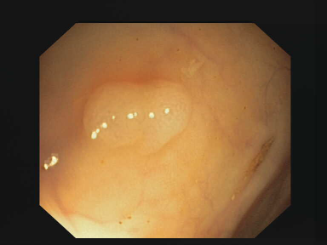

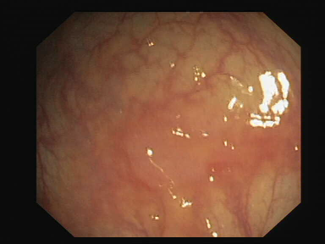

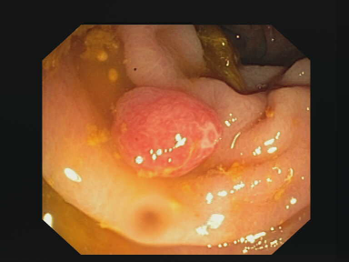
Overview of Project
Magic Box
(Segmentation)
Polyp
Polyp
Magic Box
(Classification)
Non-Polyp
Non-Polyp

Slide 6

Image Classification
SECTION TITLE SLIDE
YOUR BRAND NAME
Detecting whether the given image contains a polyp or not

Slide 7
On an average, 20% of polyps are missed during examinations. Recent studies have shown that new endoscopic devices and diagnostic tools have improved the adenoma detection rate and polyp detection rate. However, the problem of over-looked polyps remains the same
SAMPLE CONTENT SLIDE
Why Classification?

Slide 8
Classification Dataset
DATA DRIVEN SLIDE
Detect Whether the polyp is present or not
2 classes
Polyp
Non-Polyp
In healthcare, essential to have a verified dataset by health experts.
Contains 2 folders for polyp and non-polyp divided into train, test and validate
Dataset link
https://figshare.com/articles/dataset/CP-CHILD.zip/12554042

Slide 9
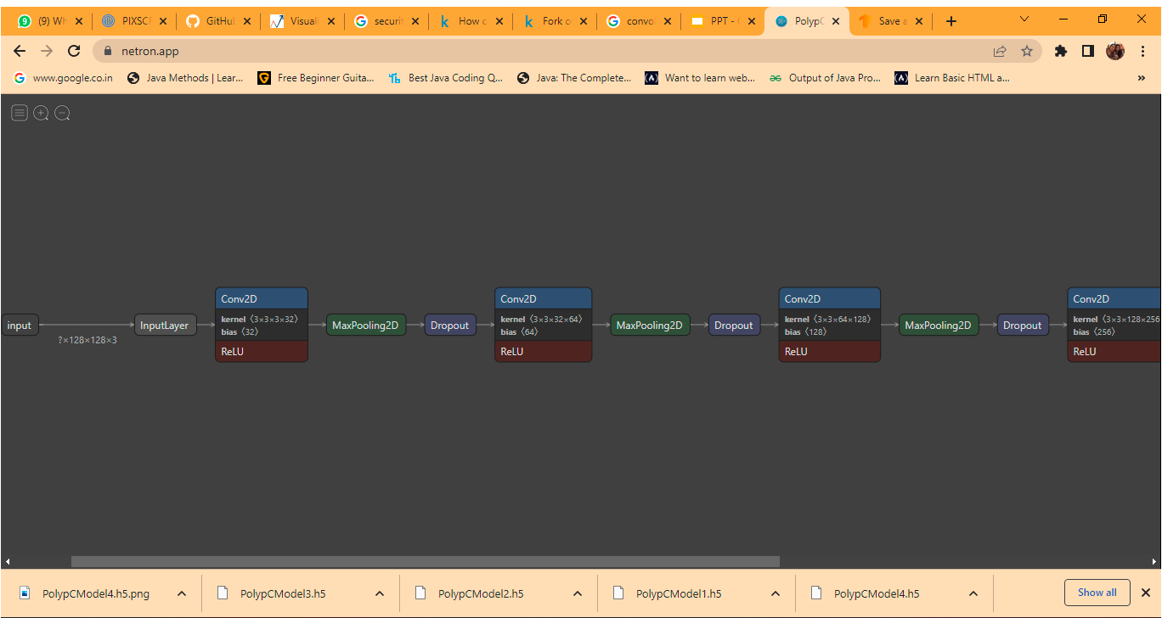
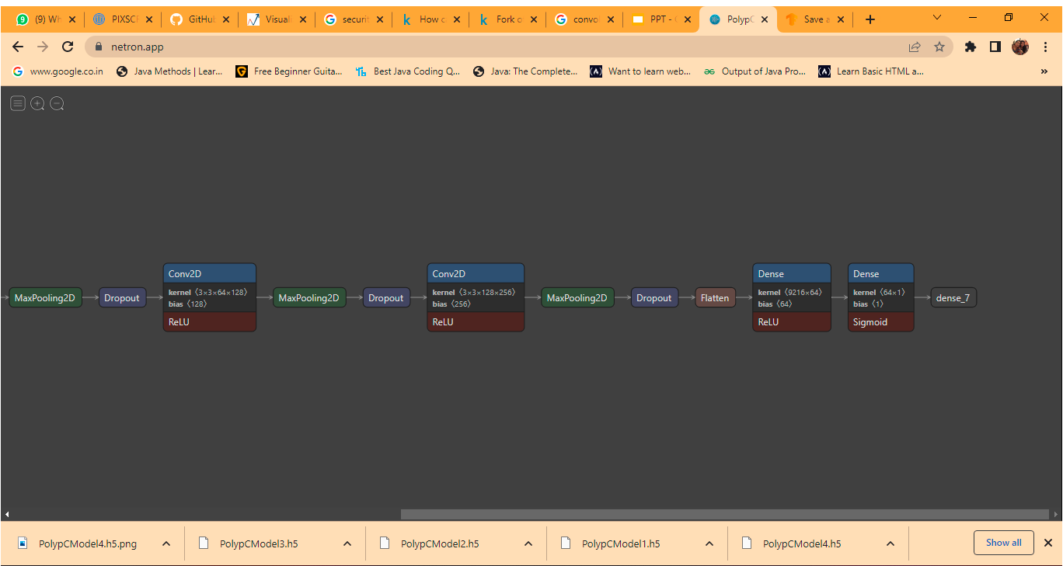

CNN Classification Model Architecture
DATA DRIVEN SLIDE

Slide 10
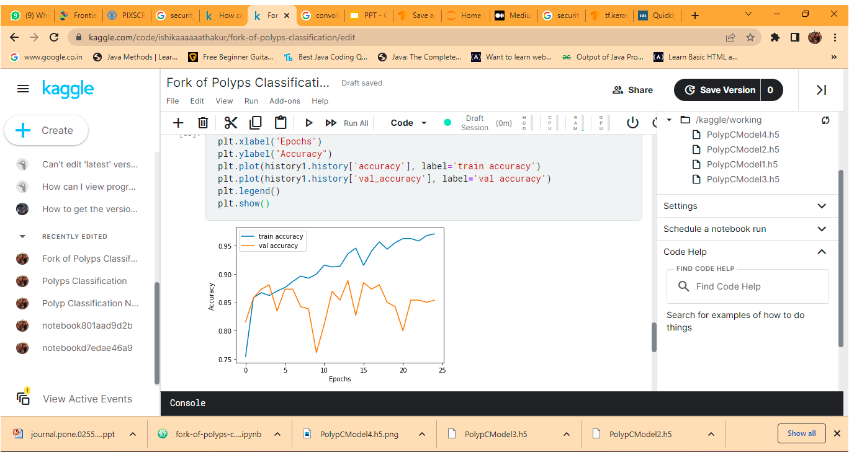
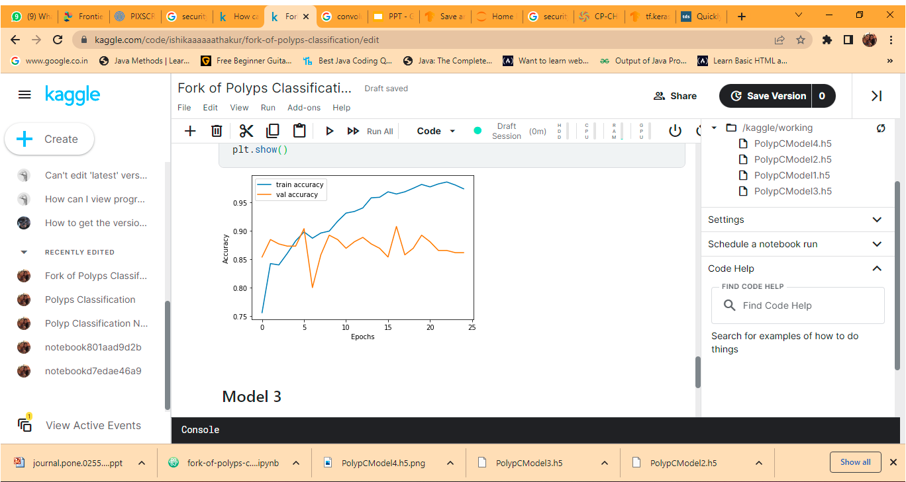
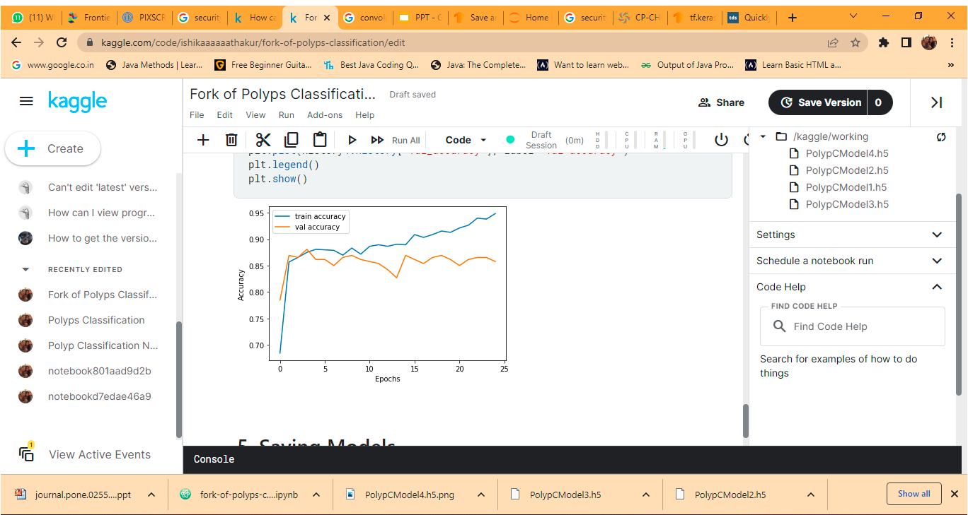
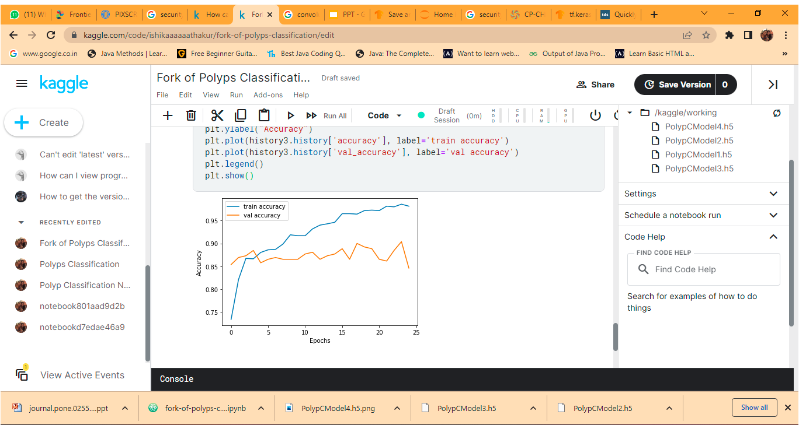
DATA DRIVEN SLIDE
Model 1
Model 2
M
O
D
E
L
C
O
M
P
A
R
I
S
O
N
Model 4
Model 3

Slide 11
Model Evaluation (Type II error)
DATA DRIVEN SLIDE
YOUR BRAND NAME
In polyp classification Recall (False Negative) is an essential metric since we need to minimize undetected polyps.
 | recall
0.0 | 0.89
1.0 | 0.98

Slide 12
Image Segmentation
SECTION TITLE SLIDE
YOUR BRAND NAME
Segmenting out the polyp from the image.

Slide 13
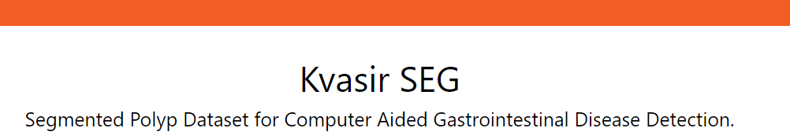
Dataset (Segmentation)
DATA DRIVEN SLIDE
YOUR BRAND NAME
Test set
1567
Train set
2239
Validation set
672

Slide 14
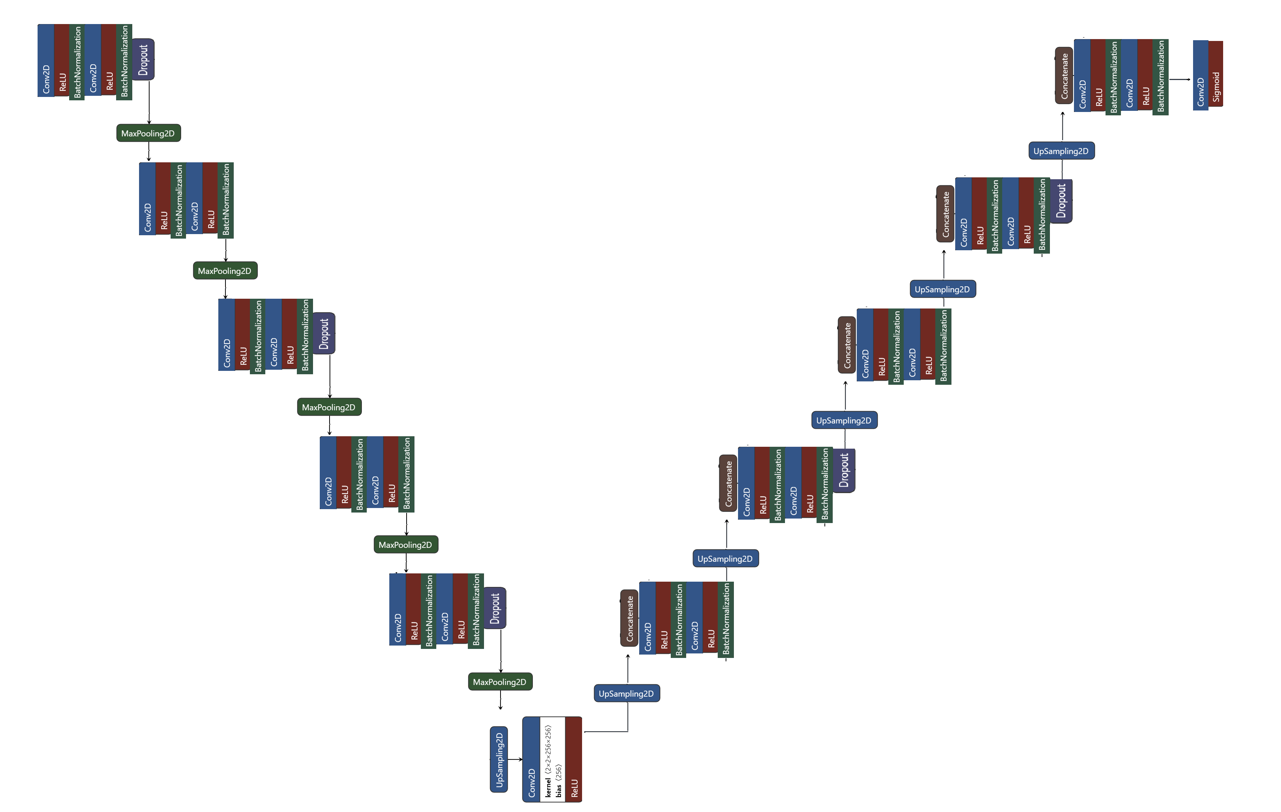
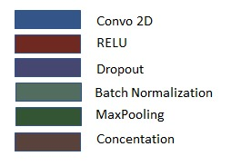
Magic Box (Segmentation))
DATA DRIVEN SLIDE
YOUR BRAND NAME

Slide 15
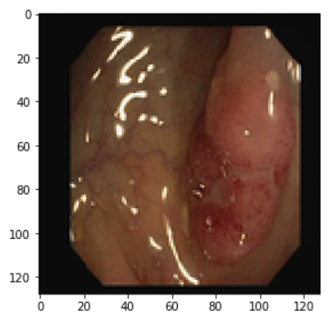
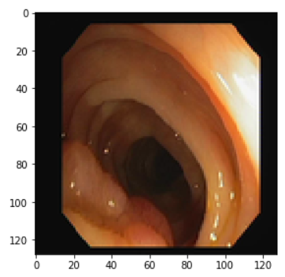
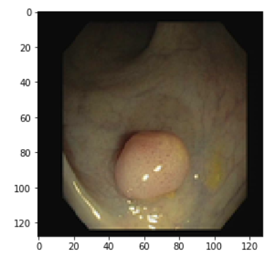
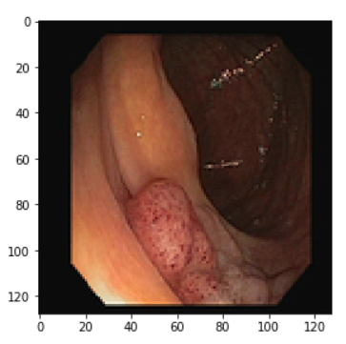
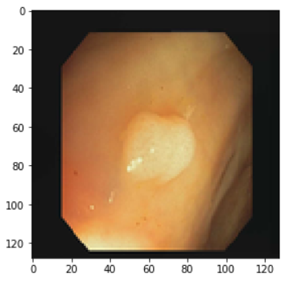
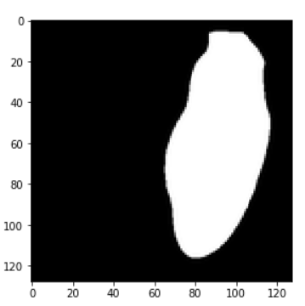
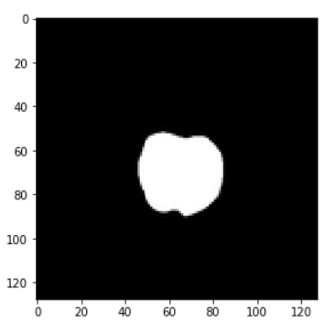
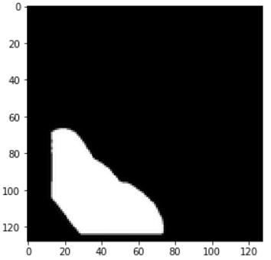
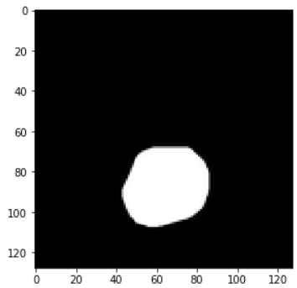
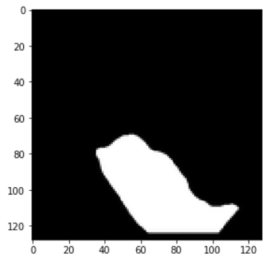
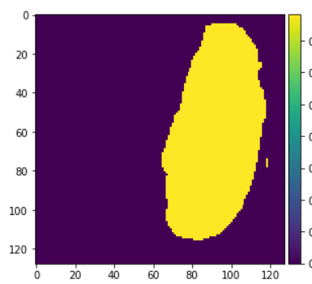
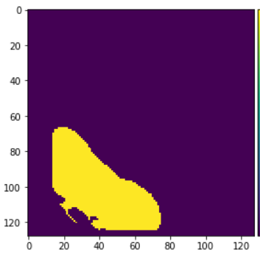
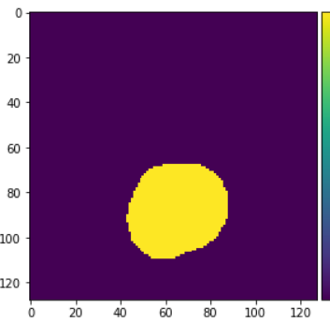
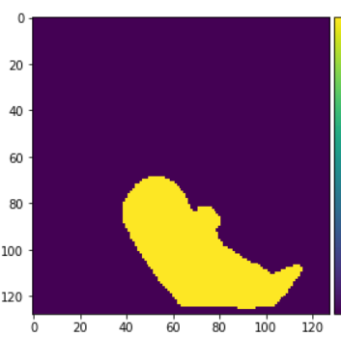
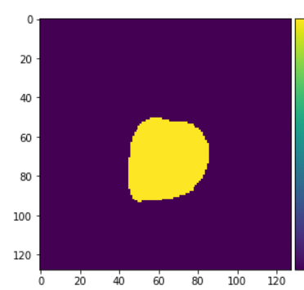
Results of DrNet
Test Image
Ground Truth
Predicted Mask
IOU Score : 0.79
Jaccard Coeff : 0.602
Dice Coeff : 0.855

Slide 16
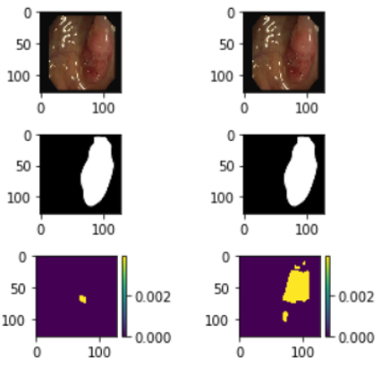
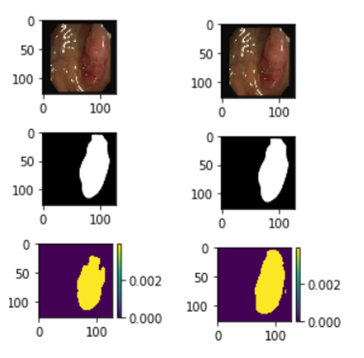
Comparison Between Models
SegNet
DrNet1
DrNet2
DrNet3
Test
SEGNET
DrNet1
DrNet2
DrNet3
Test
Images
Ground
Truth
Ground Truth
Predicted
Mask
Predicted Mask
Dret
Dropout
Dropout Alt
Regularization
Dropout Alt
Regularization

Slide 17
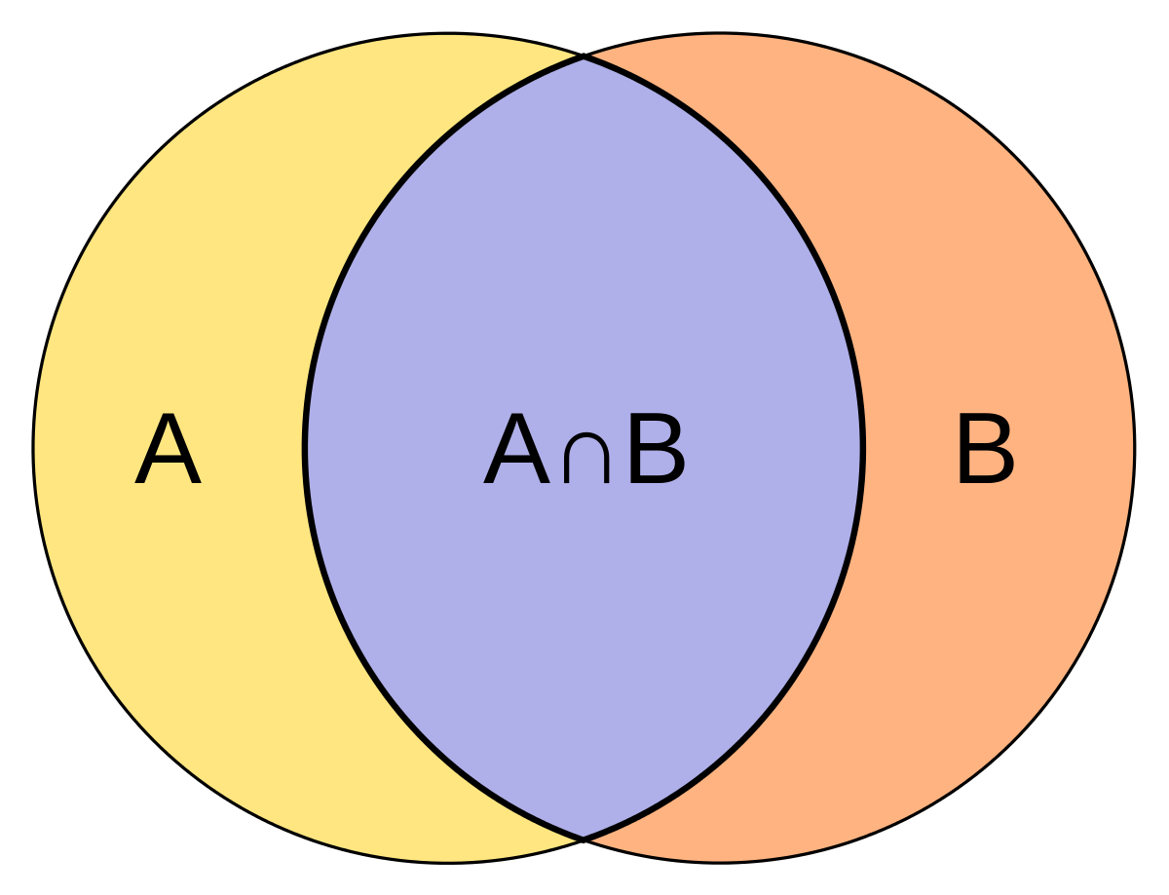
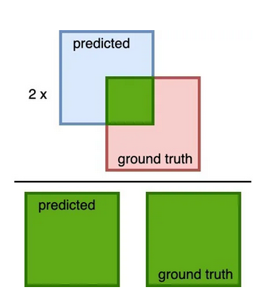
Comparison Matrix
DATA DRIVEN SLIDE
YOUR BRAND NAME
Models | Loss | Jacard Coeff | Dice Coef | IOU
SEGNET | 0.056 | 0.610 | 0.74 | 0.57
DrNet 1 (DropAlt, Reg) | 0.076 | 0.580 | 0.85 | 0.63
DrNet 2 (Reg) | 0.069 | 0.600 | 0.871 | 0.702
DrNet 3 (DropAlt) | 0.055 | 0.612 | 0.855 | 0.79

Slide 18
Data Collection-Since our model was based on the healthcare sector obtaining verified dataset by an expert is very essential. Overfitting-Since the classification dataset was limited our model faced overfitting.
SAMPLE CONTENT SLIDE
Challenges Faced

Slide 19
Security and Compliance
SECTION TITLE SLIDE
YOUR BRAND NAME
Protecting patient’s data is essential when it comes to deploying AI in healthcare.

Slide 20

AI in healthcare
To fully achieve the potential of AI in healthcare, four
major ethical issues must be addressed:
informed consent to use data,
safety and transparency,
algorithmic fairness and biases, and
data privacy are all important factors to consider

Slide 21
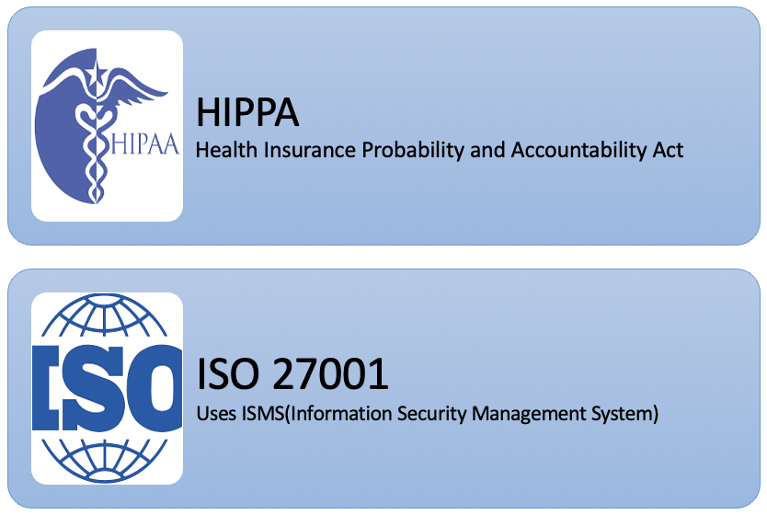
SAMPLE CONTENT SLIDE
Compliances
YOUR BRAND NAME

Slide 22
Deployment
SECTION TITLE SLIDE
YOUR BRAND NAME
Model deployment using Flask API or Azure.

Slide 23
SAMPLE CONTENT SLIDE
YOUR BRAND NAME
Deployment
Used html, flask and AJAX to deploy
Added classification and segmentation models to classify and segment the colonoscopy image

Slide 24
html
Web Page
Button
API
(flask)
Model
(TensorFlow)
Ajax
Output
client
Website: http://127.0.0.1:5000/

Slide 25
Business Model
SECTION TITLE SLIDE
YOUR BRAND NAME

Slide 26
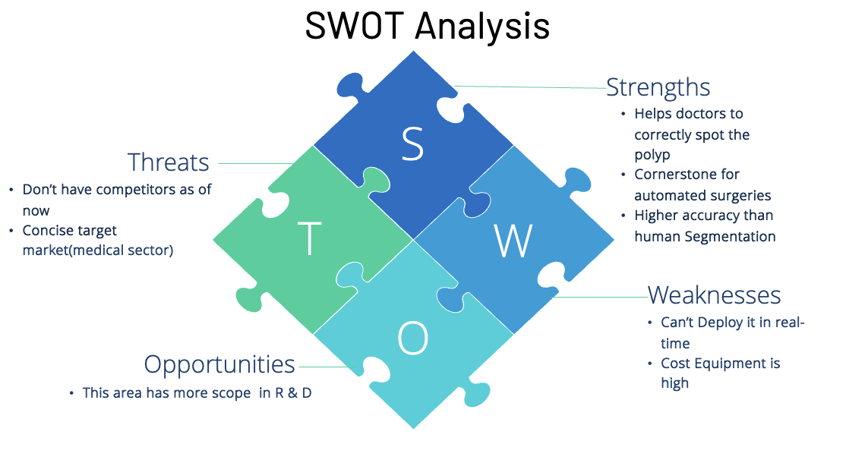

Slide 27
SAMPLE CONTENT SLIDE
YOUR BRAND NAME
Future scope
Real Time Video Segmentation
IOT implementation of Real Time Segmentation for Colonoscopy
Further Research For Better Results
Implementation for Automated Surgery

Slide 28
Thank you.
END SLIDE

